Slide 1
Developing and Validating High Risk Applications
Agus Sudjianto
SVP Risk & Technology, H2O.ai
Executive in Residence, School of Data Science, UNC Charlotte
Retired EVP Model Risk Management, Wells Fargo

Slide 2
All Models are Wrong Some are useful
Models are increasingly more complex
… and applied to high-risk applications
Model Risk: harm when model is wrong--what, how, when

Slide 3
GeN-AI is a Guessing Machine
Powerful but can be unreliable
Really good for cases with low-risk downside when answers are wrong
But, we want to use it for cases where mistakes can cause real harm (e.g., Finance, Medicine)

Slide 4
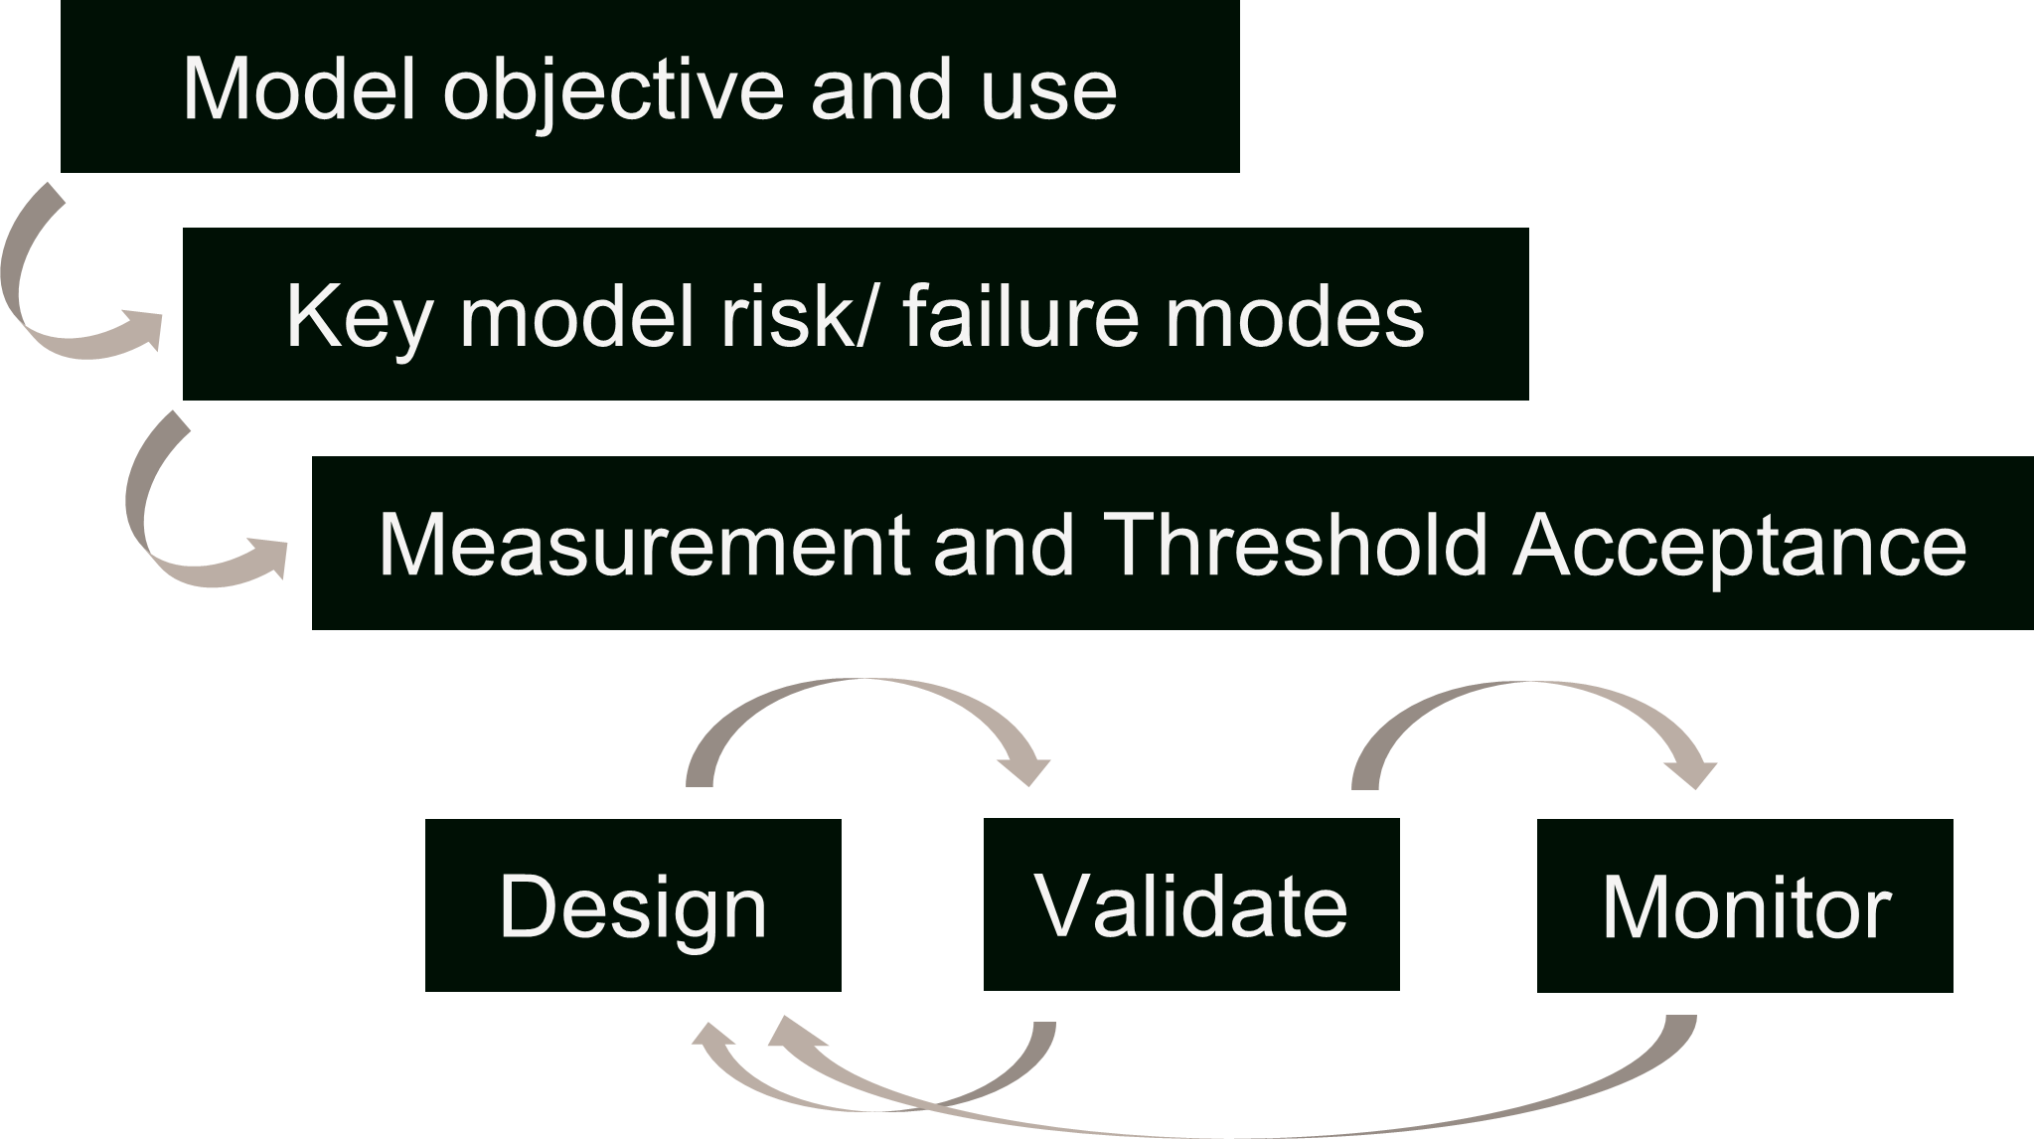
Model Risk Management (MRM)
Understanding potential harms and failure modes
Specifying risk appetite and measurement
Identifying root causes and drivers of failure
Developing failure avoidance and risk management
Independent Model Validation

Slide 5
Model Validation Challenges
Lessons from MRM in Banking Industry:
Conceptual Soundness
Outcome Analysis
On-going Monitoring
Challenges:
Tedious and labor intensive
Testing comprehensiveness
Multiple imperfect metrics

Slide 6
Conceptual Soundness
Data Quality and Suitability
Input Design and Control
Variable selection, causality and range
Prompt control
Explainability/Interpretability
Input-Output relationships
Optimization and benchmarking

Slide 7
Outcome Analysis
Model weakness identification
Reliability/Uncertainty of outputs
Robustness against noise
Resilience against operating drift
Business alignment (e.g., toxicity, fairness)

Slide 8
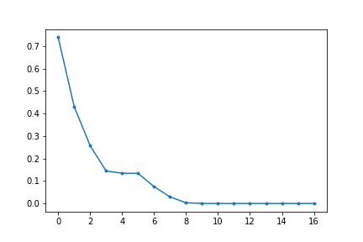
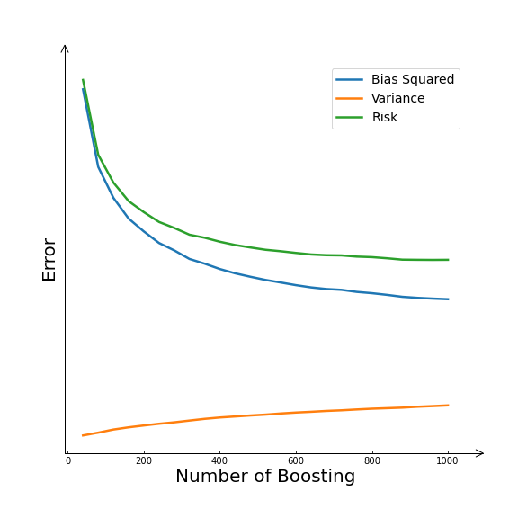
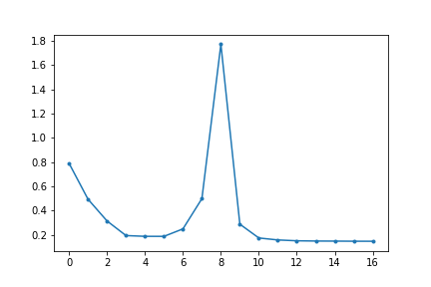
Remarkable world of over-parameterized models
Double Descent
Benign Overfitting Overfitting
Training error
Test error
But…
Model Complexity

Slide 9
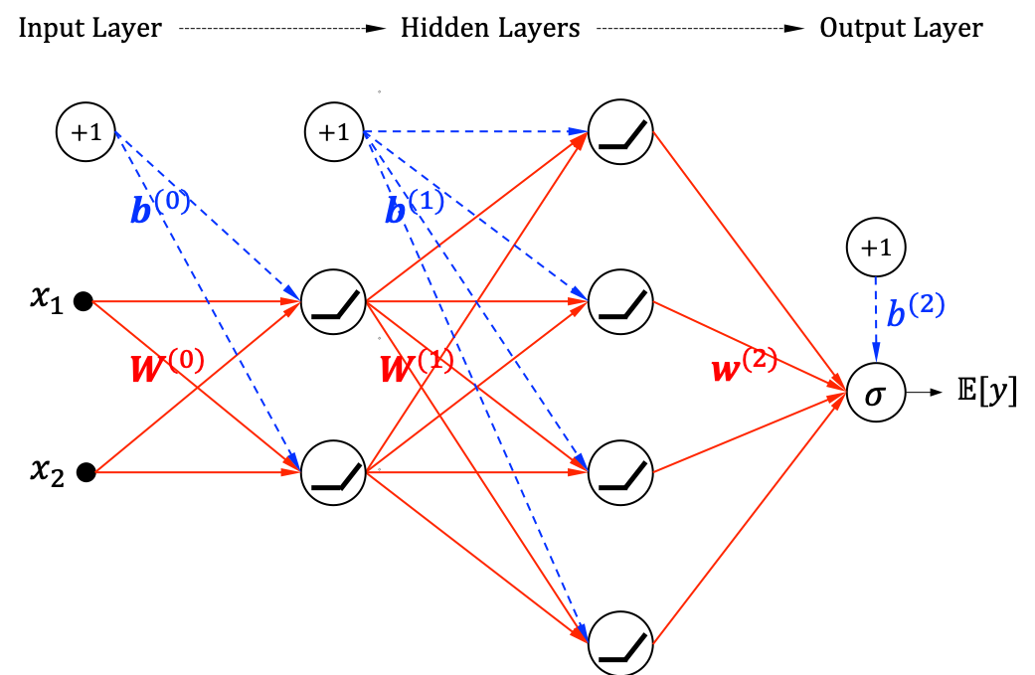
Can We Trust These Models?
Interpretability
Reliability
Uncertainty/Confidence of prediction
Robustness
Sensitivity to small input changes
Resilience
Fairness
Performance degradation under environment changes

Slide 10
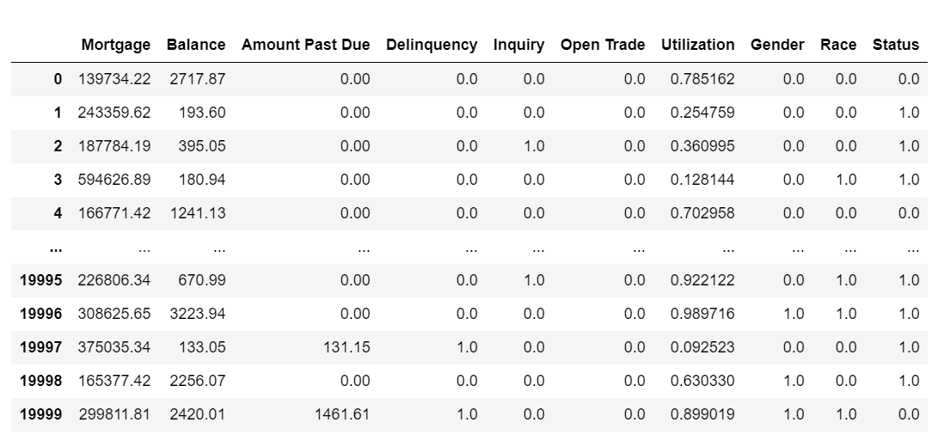
Example: Credit Data

Slide 11
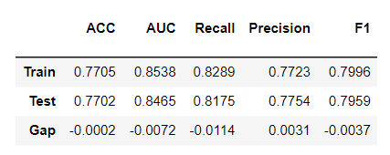
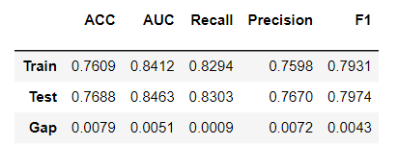
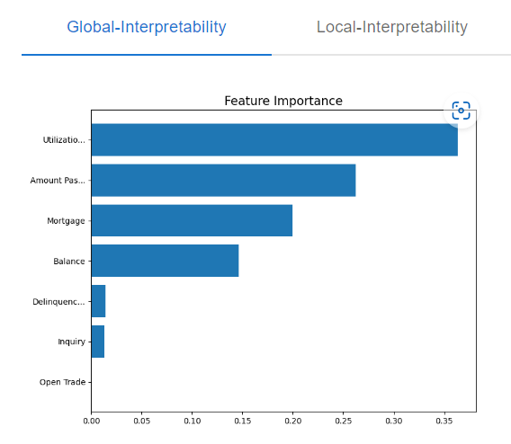
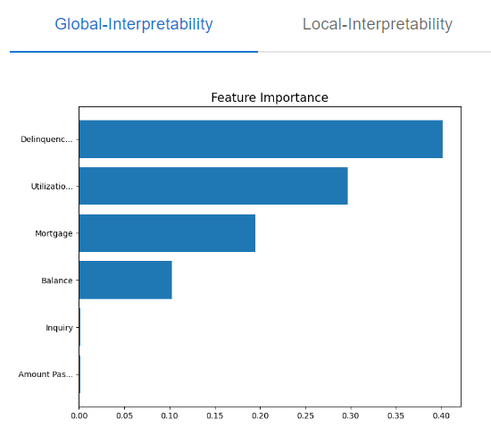
Equal Performance—Very Different Models
XGB2—Depth 2 XGBoost
GAMI Neural Networks

Slide 12
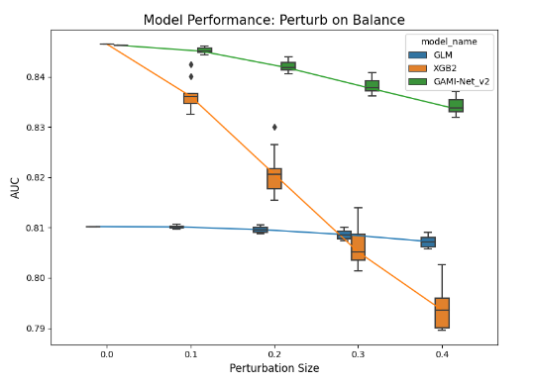
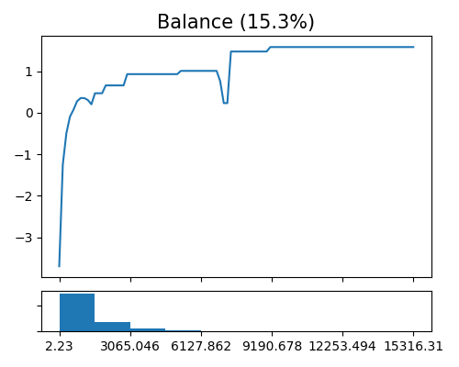
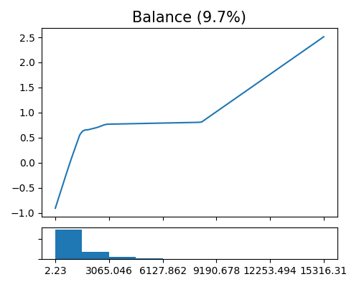
Performance is not all you need: Robustness
Robustness against noise and Explainability
Performance against noise
Effect of Balance
XGB2
GAMI-Net

Slide 13
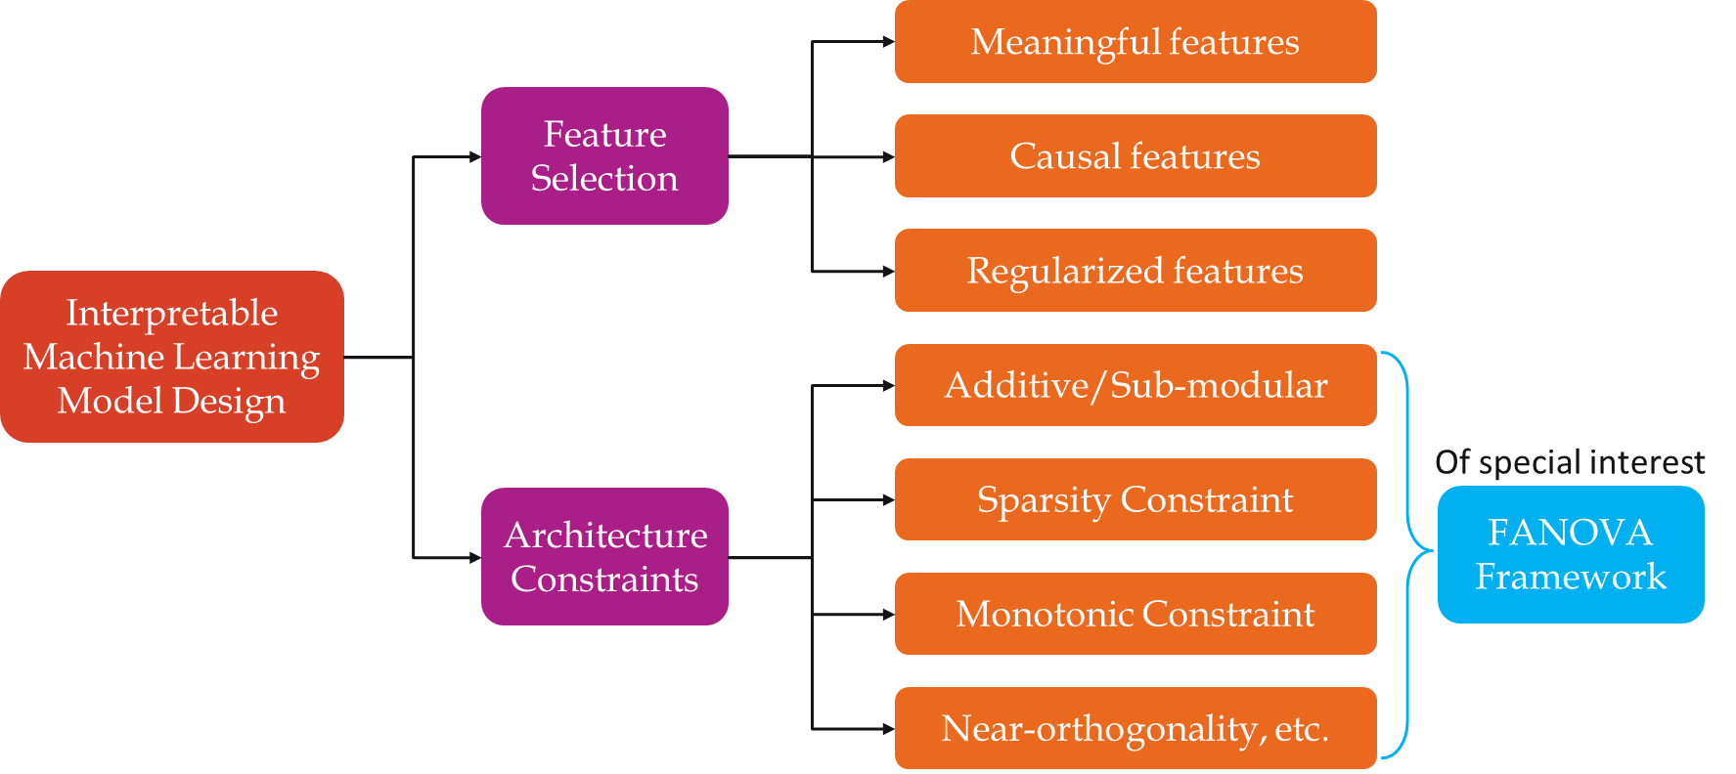
Designing Interpretable Machine Learning

Slide 14
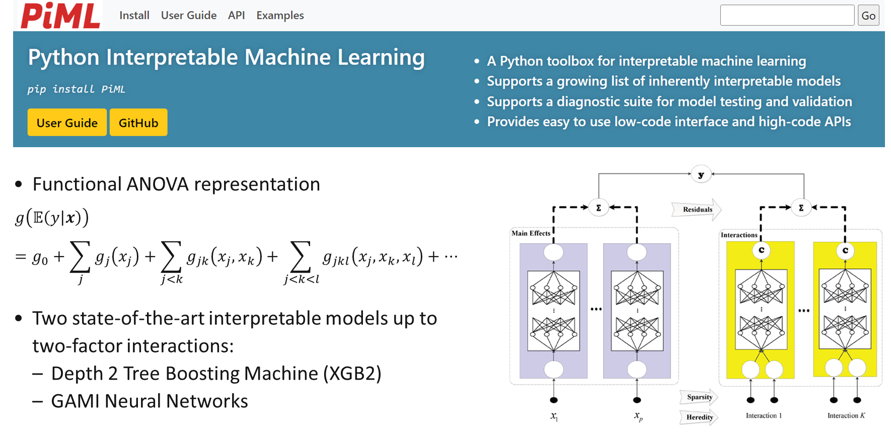
Integrated Python Package to Develop and Validate ML

Slide 15
Model Diagnostics
Identification of model weakness beyond overall performance
Error analysis: Finding regions with weaker performance
Resilient: Understanding the effect of data drift and regions with weaker performance
Reliability: Understanding prediction uncertainty its associated regions

Slide 16
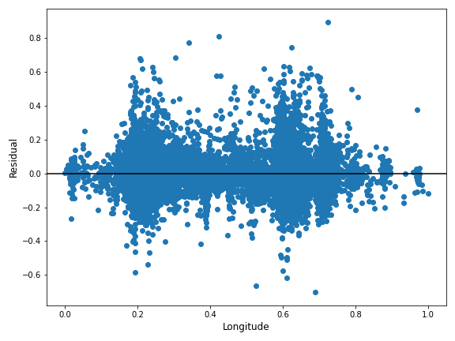
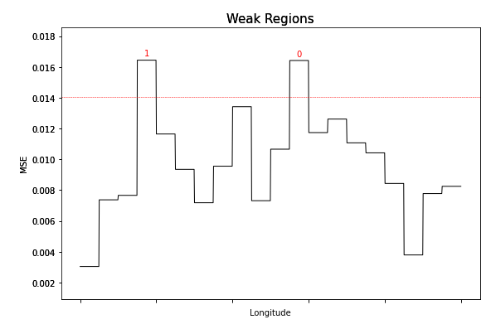
Accuracy, Residuals and WeakSpot
ML model performance is often measured by accuracy, as examined via standard ML metrics (e.g. MSE, MAE, R2, ACC, AUC, F1-score, Precision and Recall).
However, model assessment by single-valued metrics is insufficient. More granular diagnostics and alternative metrics are needed.
To check model underfitting, perform error analysis based on residuals
Residual plot marginally for each feature of interest;
WeakSpot to identify weak regions with high residuals on either training or testing data.
PiML toolbox employs several slicing techniques for WeakSpot.

Slide 17
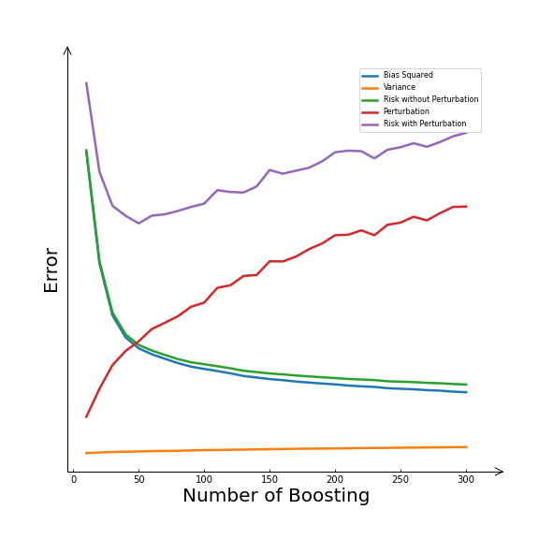
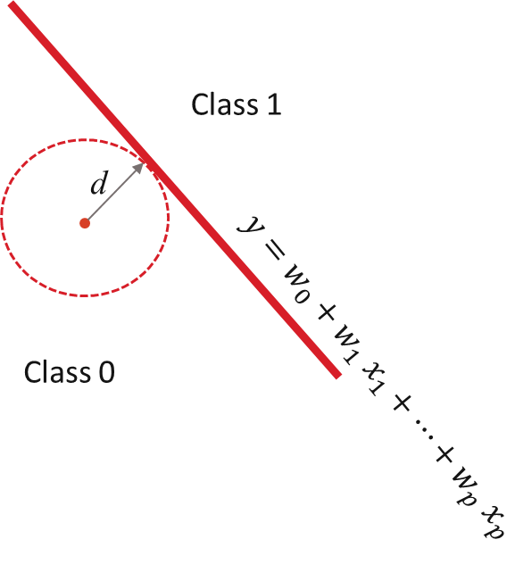
Robustness and Regularization
More complex models are less robust against input perturbation
Maximizing model robustness == Minimizing model error for largest perturbation

Slide 18
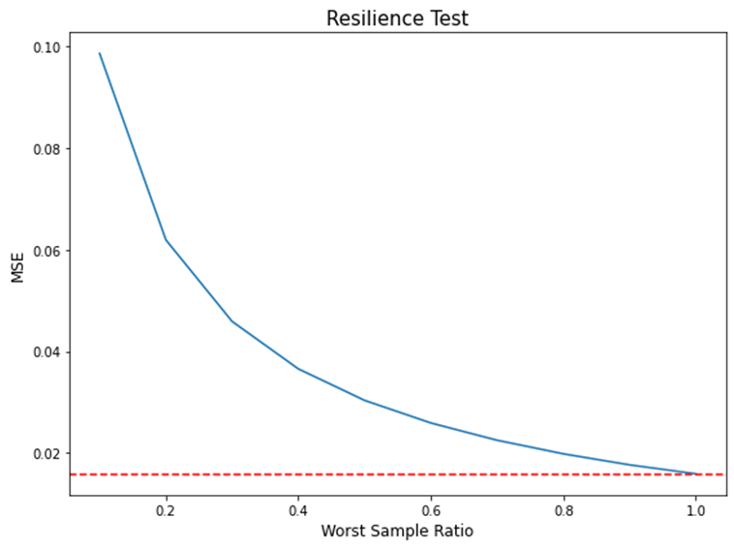
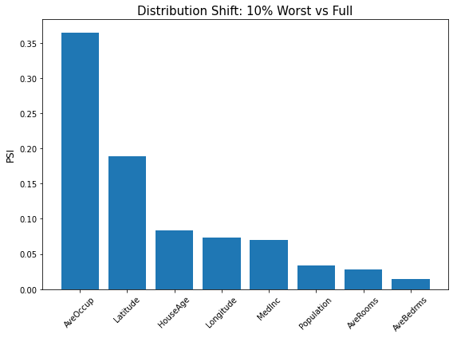
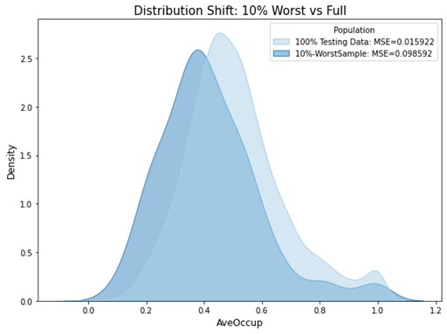
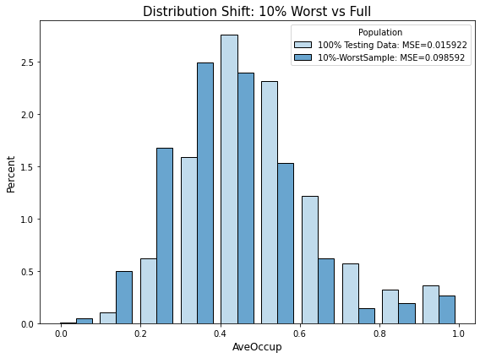
Resilience: impacts of Distribution shift
Sensitivity of model performance against distribution shift
Worst case scenario
Difficult to predict
Regions with larger errors
Extreme cases or ‘Outliers’
Identify important factors or conditions to monitor during model operations

Slide 19
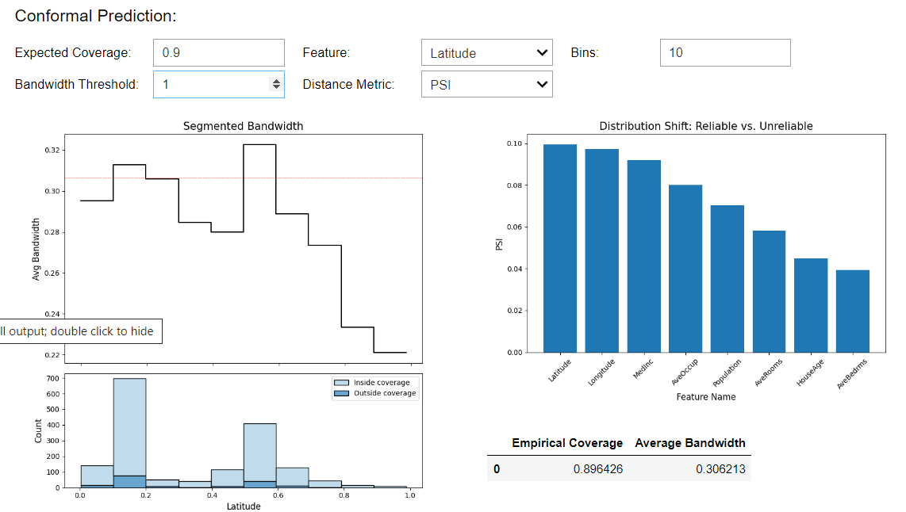
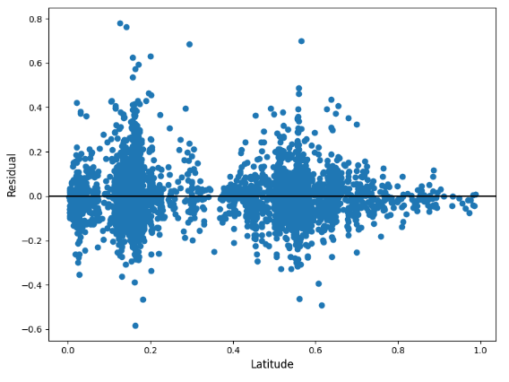
Reliability: Prediction Uncertainty

Slide 20
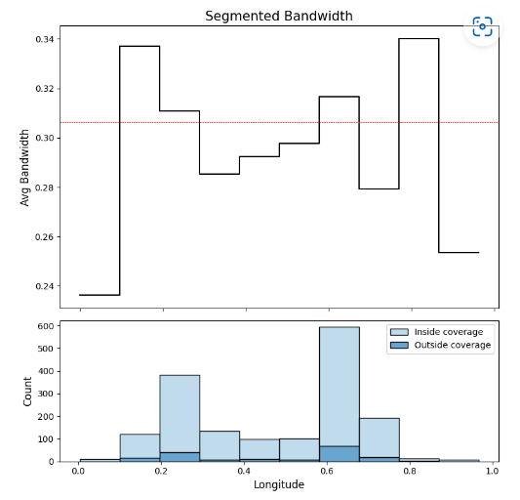
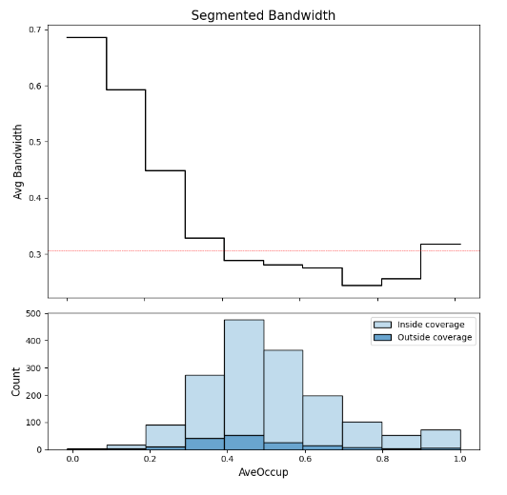
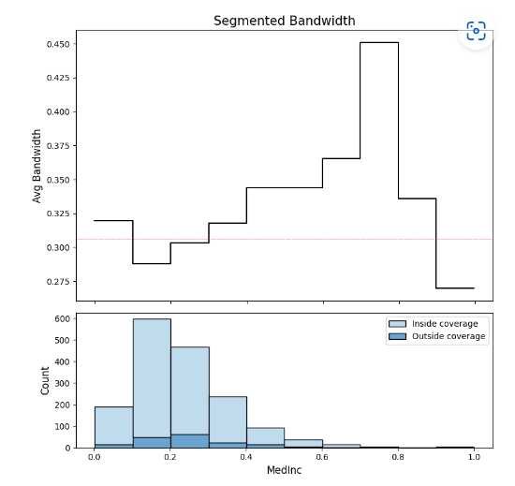
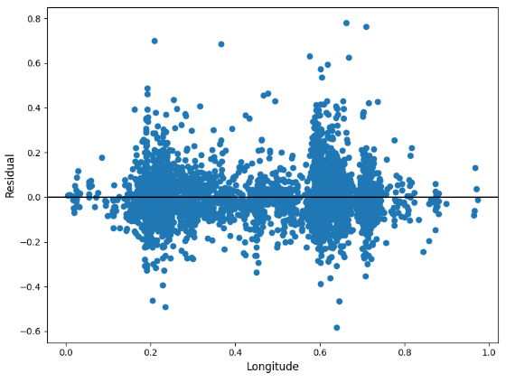
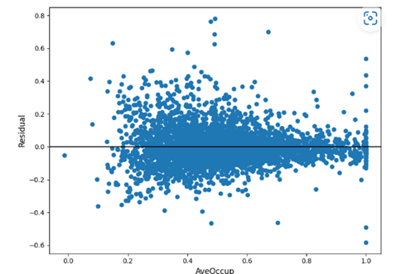
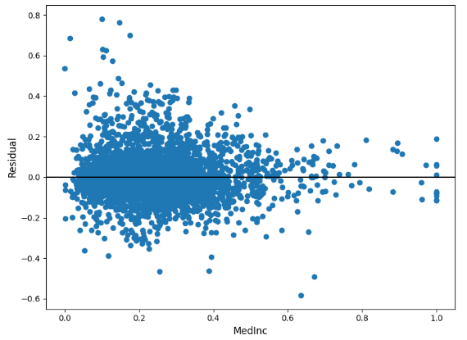
Prediction Uncertainty

Slide 21
How About GeN-AI?
How do we validate and test them?

Slide 22




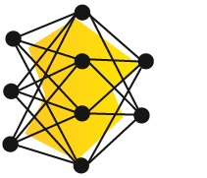
Comprehensive Validation of an LLM is Hard
Large training data, NOT all clean
Training data for LLMs is comprised of data from varied sources. It is an arduous task to guarantee the quality of the data. The size of the data is very large. For example, Llama 3 is trained on 15T tokens.
Useful & Safe Response
Wikipedia
~ ∞ Prompts
GitHub
15T Tokens
Incorrect Information
Close to infinite prompting possibilities
A generic LLM chat bot that is open to the public can receive a large variety of prompts on a large number of topics including harmful and hateful nature.
Textbooks
Hallucinations
70B Params
Wide range of outputs, NOT all useful
Large amount of training data and vast variety of prompts produce wide range of outputs. Users are often prompt-engineering to generate the desired output. And the model owners are continuously patching the guardrails and the LLMs.
YouTube
Bias
more …
Harmful Advice

Slide 23

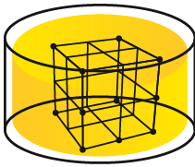
Comprehensive Validation of RAG is possible
~ ∞ Prompts
Finite amount of Documents
Unlike the training data of an LLM, Documents ingested into the Vector DB are often much smaller and easy to verify and clean.
Useful & Safe Response
Relevant
Yes
Incorrect Information
Only allow prompts relevant to the Document
A small classification model can be trained to identify prompts unrelated to the information in the selected set of documents.
Documents
Vector DB
LLM
Hallucinations
RAG
Limited range of outputs
Controlling the set of documents and prompts results in limited set of outputs.
Bias
Harmful Advice

Slide 24

User Workflow
1
Q&A Pair Curation
2
3
4
5
Human Review
Evaluate
Interpret
Outcome Analysis
Use LLMs to automatically create diverse Q&A pairs.
Q&A pairs created per topic in the document.
Choose evaluators (i.e. accuracy, bias, hallucination, etc.) to compare RAG+LLM pipelines against the auto-generated Q&A pair.
Understand where the LLM pipeline performs poorly and where it performs well.
Does the pipeline perform poorly for certain topics or certain types of questions?
Additional tests for robustness, reliability, and resiliency using information on where the pipeline performs poorly from the Interpretability step.
Subject Matter Experts review only a small portion of the Q&A pairs that are deemed to have the biggest impact on the evaluation.

Slide 25
HOW WOULD WE DO IT FOR GENAI AT SCALE?
Conceptual Soundness
Outcome Analysis
Document Collection
Q&A List
H2OGPTe
Benchmarking
Sampling Human Eval
Auto-Prompts
Auto Q&A Generation
Validated Model
EvalStudio
Metrics
Testing
Retrieval
Summarization
Hallucination
Business alignment
Weakness Identification
Weak topics/concepts
Interpretability
LLM
Embedding Models
Robustness
Prompt perturbation
Adversarial perturbation
Reliability
Token generation entropy
Explainability
Dimensionality reduction
Topic/concept models
Resilience
Simulated distribution drift

Slide 26
Model Validation Overview
01
Automated Test Case Generation
02
Interpretable Test Results
03
Low-Code Diagnostic Widgets
04
Comprehensive Evaluation Metrics
Automatically generate test cases based on documents associated with the RAG system to evaluate model weakness, robustness, and resilience.
Present test case results in a clear and interpretable manner, enabling users to identify and understand the issues causing test failures.
Provide a suite of low-code widgets within a Jupyter notebook environment to assist in diagnosing and resolving issues identified during testing.
Connection with EvalStudio for comprehensive and automated evaluation of retrieval, summarization, hallucination, business alignment (e.g., toxicity) etc
05
Comprehensive Model Benchmarking
06
Comprehensive Outcome Analysis
07
Human Eval Confirmation
Identification of model weakness and test for (1) Robustness against invariance and adversarial perturbation, (2) Output reliability and (3) Resilience against inputs/usage drift
Connection with H2OGPTe to compare model performance against various alternatives.
Human evaluation confirmation through sampling

Slide 27
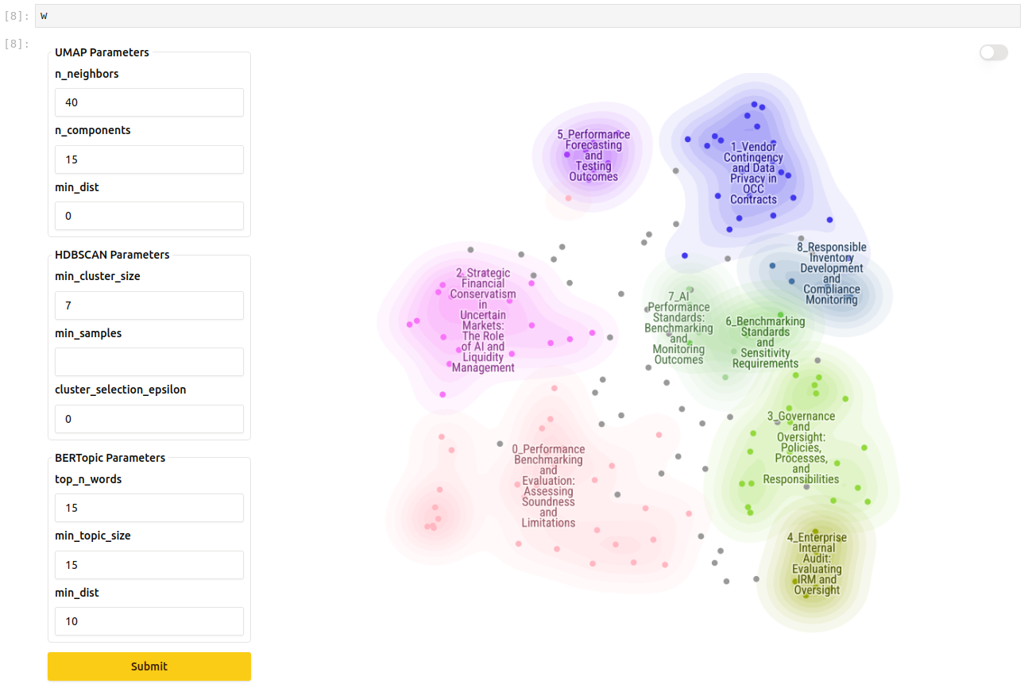
Topic Modeling - Interpretability

Slide 28
AI is a Guessing Machine
Powerful but can be unreliable
Really good for cases with low-risk downside when answers are wrong
But, we want to use it for cases where mistakes can cause real harm (e.g., Finance, Medicine)

Slide 29
Comprehensive Validation of an LLM is Hard
Large training data, NOT all clean
Training data for LLMs is comprised of data from varied sources. It is an arduous task to guarantee the quality of the data. The size of the data is very large. For example, Llama 3 is trained on 15T tokens.
Useful & Safe Response
Wikipedia
~ ∞ Prompts
GitHub
15T Tokens
Incorrect Information
Close to infinite prompting possibilities
A generic LLM chat bot that is open to the public can receive a large variety of prompts on a large number of topics including harmful and hateful nature.
Textbooks
Hallucinations
70B Params
Wide range of outputs, NOT all useful
Large amount of training data and vast variety of prompts produce wide range of outputs. Users are often prompt-engineering to generate the desired output. And the model owners are continuously patching the guardrails and the LLMs.
YouTube
Bias
more …
Harmful Advice

Slide 30
Comprehensive Validation of RAG is possible
~ ∞ Prompts
Finite amount of Documents
Unlike the training data of an LLM, Documents ingested into the Vector DB are often much smaller and easy to verify and clean.
Useful & Safe Response
Relevant
Yes
Incorrect Information
Only allow prompts relevant to the Document
A small classification model can be trained to identify prompts unrelated to the information in the selected set of documents.
Documents
Vector DB
LLM
Hallucinations
RAG
Limited range of outputs
Controlling the set of documents and prompts results in limited set of outputs.
Bias
Harmful Advice

Slide 31
User Workflow
1
Q&A Pair Curation
2
3
4
5
Human Review
Evaluate
Interpret
Outcome Analysis
Use LLMs to automatically create diverse Q&A pairs.
Q&A pairs created per topic in the document.
Choose evaluators (i.e. accuracy, bias, hallucination, etc.) to compare RAG+LLM pipelines against the auto-generated Q&A pair.
Understand where the LLM pipeline performs poorly and where it performs well.
Does the pipeline perform poorly for certain topics or certain types of questions?
Additional tests for robustness, reliability, and resiliency using information on where the pipeline performs poorly from the Interpretability step.
Subject Matter Experts review only a small portion of the Q&A pairs that are deemed to have the biggest impact on the evaluation.

Slide 32
HOW WOULD WE DO IT FOR GENAI AT SCALE?
Conceptual Soundness
Outcome Analysis
Document Collection
Q&A List
H2OGPTe
Benchmarking
Sampling Human Eval
Auto-Prompts
Auto Q&A Generation
Validated Model
EvalStudio
Metrics
Testing
Retrieval
Summarization
Hallucination
Business alignment
Weakness Identification
Weak topics/concepts
Interpretability
LLM
Embedding Models
Robustness
Prompt perturbation
Adversarial perturbation
Reliability
Token generation entropy
Explainability
Dimensionality reduction
Topic/concept models
Resilience
Simulated distribution drift

Slide 33
Model Validation Overview
01
Automated Test Case Generation
02
Interpretable Test Results
03
Low-Code Diagnostic Widgets
04
Comprehensive Evaluation Metrics
Automatically generate test cases based on documents associated with the RAG system to evaluate model weakness, robustness, and resilience.
Present test case results in a clear and interpretable manner, enabling users to identify and understand the issues causing test failures.
Provide a suite of low-code widgets within a Jupyter notebook environment to assist in diagnosing and resolving issues identified during testing.
Connection with EvalStudio for comprehensive and automated evaluation of retrieval, summarization, hallucination, business alignment (e.g., toxicity) etc
05
Comprehensive Model Benchmarking
06
Comprehensive Outcome Analysis
07
Human Eval Confirmation
Identification of model weakness and test for (1) Robustness against invariance and adversarial perturbation, (2) Output reliability and (3) Resilience against inputs/usage drift
Connection with H2OGPTe to compare model performance against various alternatives.
Human evaluation confirmation through sampling

Slide 34
Topic Modeling - Interpretability

